Slide 1
Assignment 2
Foot print

Slide 2
What is footprinting and how does it work?
Footprinting is an ethical hacking technique used to gather as much data as possible about a specific targeted computer system, an infrastructure and networks to identify opportunities to penetrate them. It is one of the best methods of finding vulnerabilities. The process of cybersecurity footprinting involves profiling organizations and collecting data about the network, host, employees and third-party partners. This information includes the OS used by the organization, firewalls, network maps, IP addresses, domain name system information, security configurations of the target machine, URLs, virtual private networks, staff Ids, email addresses and phone numbers.

Slide 3
Types of Foot print
Active footprinting:
Active footprinting describes the process of using tools and techniques, like using the traceroute commands or a ping sweep – Internet Control Message Protocol sweep – to collect data about a specific target. This often triggers the target’s intrusion detection system (IDS). It takes a certain level of stealth and creativity to evade detection successfully.

Slide 4
Passive foot print:
As the name implies, passive footprinting involves collecting data about a specific target using innocuous methods, like performing a Google search, looking through Archive.org, using NeoTrace, browsing through employees’ social media profiles, looking at job sites and using Whois, a website that provides the domain names and associated networks fora specific organization. It is a stealthier approach to footprinting because it does not trigger the target’s IDS.

Slide 5
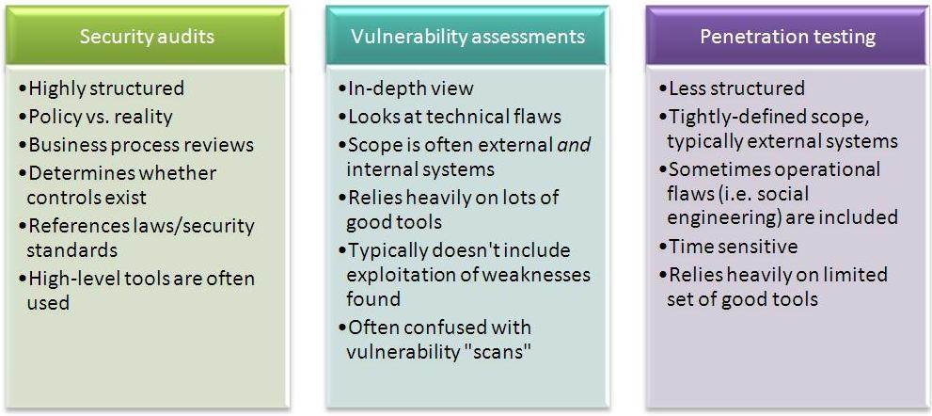
How do you start footprinting?

Slide 6
Process to start
Footprinting processes start with determining the location and objective of an intrusion. Once ethical hackers identify a specific target, they gather information about the organization using nonintrusive methods, such as accessing the organization’s own webpage, personnel directory or employee bios. Ethical hackers collect this information and initiate social engineering campaigns to identify security vulnerabilities and achieve ethical hacking goals.

Slide 7
Advantages of foot print
Footprinting techniques in ethical hacking help businesses identify and secure IT infrastructure before a threat actor exploits a vulnerability. Users can also build a database of known vulnerabilities and loopholes. Footprinting also helps companies better understand their current security posture through analysis of data gathered about the firewall, security configuration and more. Users can update this list periodically and use it as a reference point during security audits.

Slide 8
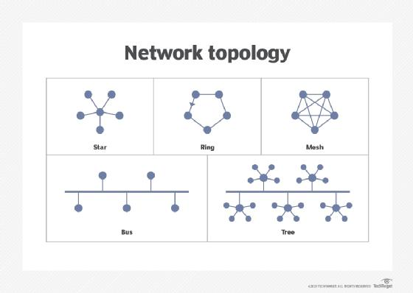
Network topology

Slide 9
Other types of foot printings
DNA footprinting is the method used to identify the nucleic acid sequence that binds with proteins. An ecological footprint is an approach to measuring human demand for natural capital or resources. It calculates the amount of natural resources required to support people or an economy. Ecological footprinting uses an ecological accounting system to keep track of this demand.

Slide 10
Understanding Ethical hacking
The best way to check your business can withstand a cyber attack is by attacking it yourself. This way, should you have any vulnerabilities in your defences, you’re not at risk of sharing sensitive data. Ethical hackers, sometimes called white hat hackers, are typically information security experts granted permission to break into a business system to uncover security vulnerabilities. In doing so, they can demonstrate to the business how to prevent criminals from obtaining access. Ethical hacking can also involve testing employees’ responses to an attempted attack. Businesses are increasingly realising the benefits of this, and turning to ethical hackers to test and strengthen their cyber resilience.

Slide 11
Ethical hacking: What, why, and overcoming concerns
We find out why and how hitting your own business with a cyber attack can help improve security
According to internet service provider (ISP) Beaming, 2020 was the busiest year on record for cyber attacks against UK firms, which is no surprise, given that reliance on technology increases every year.
Given the increase in number and variety of attacks, one would hope businesses are ready to defend themselves. Unfortunately, that is not the case. Recent research by the Scottish Business Resilience Centre found that 38% of Scottish businesses do not feel prepared for a cyber attack. It’s therefore more critical than ever for businesses to strengthen their cyber defences to stay ahead of cyber criminals – but they clearly need help. Enter: ethical hackers, or offensive security testers and researchers.

Slide 12
Main role
“The best way to check your business can withstand a cyber attack is by attacking it yourself. This way, should you have any vulnerabilities in your defences, you’re not at risk of sharing sensitive data”

Slide 13
Different kinds of information that can be gathered from Footprinting are as follows:
The operating system of the target machine Firewall IP address Network map Security configurations of the target machine Email id, password Server configurations URLs VPN

Slide 14
Steps to follow foot print
1. Identifying Targets The first step is to identify which systems or organizations to footprint by scanning networks for open ports or performing reconnaissance using Google searches and tools like Shodan. 2. Gathering Information After the target has been identified, the next step is to gather as much information about it as possible using tools like Nmap, Netcat, and Whois to identify open ports and services, usernames and passwords, web server information, and more. 3. Analyzing Results After all relevant data has been collected, it needs to be analyzed to determine the most vulnerable points. This is done by identifying common weaknesses across multiple systems or comparing results against known exploits. 4. Planning Attacks The final step is to use the information gathered during footprinting to plan a successful attack against the target’s systems, networks, and devices. This may involve developing custom exploits or choosing a suitable attack vector based on the data collected.

Slide 15
Tips to prevent footprinting attacks
Restrict unnecessary network traffic using a firewall – Set rules to prevent unauthorized DNS traffic and limit ICMP ping requests. Monitor events and log files for suspicious traffic, malformed DNS queries, and use of advanced search parameters. Use proxy servers to block fragmented or malformed packets, which are employed in footprinting attempts. Perform TCP, UDP, and ICMP scans on the IP address space to assess network vulnerabilities and detect open ports ahead of potential threats. Set your DNS records so that the information is private. Ensure that only authorized users have access to essential ports and services on systems. Engage the services of reputable penetration testers to help you identify security gaps. Regularly monitor and update vulnerabilities to protect systems against exploits.

Slide 16
Conclusion
Footprinting is the art of gathering essential information from target organizations about their networks and systems for potential vulnerabilities. Both penetration testers and threat actors use footprinting as the initial step to gather intelligence for constructing a technical map of the selected organization. Footprinting involves both passive and active methods to gather different types of data sets. Footprinting possesses both advantages and risks. Organizations must identify these information-gathering techniques and establish defenses against potential threat actor-driven footprinting attacks.

